Slide 1
Team Skylight
UAV Outback Challenge 2010 Oral presentation

Slide 2
System Design
Airframe: Rascal-110 kit
Autopilot: Realtime Java application (custom made)
IMU: Accel+gyro+magnetometer running on multi core processor (custom made software)
Datalink: Aerocomm 900MHz 1W modem
Video: Sony blockcam with gyro stabilized PTZ gimbal (custom made)
Control: STANAG 4586
Ground station: Notebook based multi-operators/views Java application (custom made)

Slide 3
System Design

Slide 4
System Evolution
System | Version 1 (2008) | Version 2 (2009) | Version 3 (2010)
Main Data Link | 3G/GSM based | WiFi with high gain antennas | 900MHz modem with omni antennas
EO sensor | Nokia N95 camera | Fixed camera | Custom made georeferenced gimballed camera
Image transmission | Photos over 3G | 2.4Ghz Video transmitter | 2.4Ghz Video transmitter
UAV Control | Custom | Custom | STANAG-4586
Sensor/actuator processing hardware | Single microcontroller | Single microcontroller | Two 8 core microcontroller on 4 layered PCB
Onboard computer | Nokia N95 with MIDP autopilot | VIA EPIA PX x86 | Gumstix Overo ARM
IMU | Thermopiles/pressure sensors and 5Hz GPS | Thermopiles/pressure sensors and 5Hz GPS | Gyro/accel/magn/pressure sensors and 10Hz GPS
Watchdogs | Hardware | Hardware | Hardware and all software elements
Power plant |  |  | 3W

Slide 5
Approach to Safety
Rules of Safety as part of every mission
Setup the various Safety Actions needed to handle dangerous situations
Ex.: If “Insufficient thrust power”, then “Loiter with roll descending to ground”
Define mission limits
altitudes, boundaries, time of operation etc
Define manual recovery location
Mission validation

Slide 6
Approach to Safety
Flight Termination
A completely independent element from the main processor that monitors overall system heart beat signals.
A backup battery gives it the hability to perform Flight Termination even if the main battery dies or when in RC control

Slide 7
Approach to Safety
Loss of Datalink
A special Safety Action was developed to perform the link recovery procedures, so if it is not detected any kind of link activity during a certain amount of time, that Action will take place
If link recovery is not possible, the vehicle will return to home and wait for a manual RC recovery
If manual recovery is not possible, Flight Termination will take place

Slide 8
Approach to Safety
Loss of GPS
A special Safety Action was developed to handle all procedures needed for a safe GPS recovery attempt
If autopilot doesn’t get current vehicle position updated regularly, it will activate this Safety Action
If GPS link recovery is not possible, the ground operator will return to home by comanding roll using a joystick while being guided by video camera and IMU telemetry

Slide 9
Approach to Safety
Autopilot lockup
If any element of autopilot gets locked (hw or sw), no heart beat signals will be received by the Flight Termination device, so it will execute Flight Termination

Slide 10
Expected performance
Safe operation on all phases
Extensive tests were done on low, mid, high controls, communications, navigation and in-flight controls. Various improvements on those subsystems were added as result of the tests
Enough autonomy for the mission
We use a 3W engine with a small carburator along with a 65Wh LiPo battery

Slide 11
Expected performance
No communication blackouts
The chosen modem is suitable for long range operations. Tests showed great performance.
We can monitor modem RSSI in realtime, so if communication is going to be bad, we can take safety actions before that happens.

Slide 12
Expected performance
Controllable delivery of the bottle
An object drop planner utility on ground station will calculate a flight plan for bottle drop based on wind estimation and upload it to vehicle when authorized
Our tests showed that creating manually a good plan for object drop while in mission would be very hard

Slide 13
Expected performance
Take-off to search area: 5 min
Primary search: 10 min
Secondary search: 6 min
Back to home: 5 min
Flight time: ~30 min

Slide 14
Lessons learnt
An UAV System has many complex parts, from aerodynamics to hardware, software, mechanics, legal and personnel perspectives
The success of the platform depends on well trained pilots/operators using systems that were built with extreme care and tested against different situations

Slide 15
Lessons learnt
During a flight, things happen very fast. The pilot/operator needs to be prepared for a fast and good reaction too
Simulation is essential for developing this kind of platform
Even initial PID parameters adjusted in simulators proved to be effective in real world

Slide 16
Lessons learnt
Each subsystem needs time of maturation, so iterative development is very important
Creating a UAV system almost from scratch is very hard, but a lot of fun too!
Come to Australia at least 2 weeks before the Challenge!
Our flight was cancelled and our baggage was delayed so we lost almost 4 days waiting for them and had only 1.5 day for all assemblies!

Slide 17
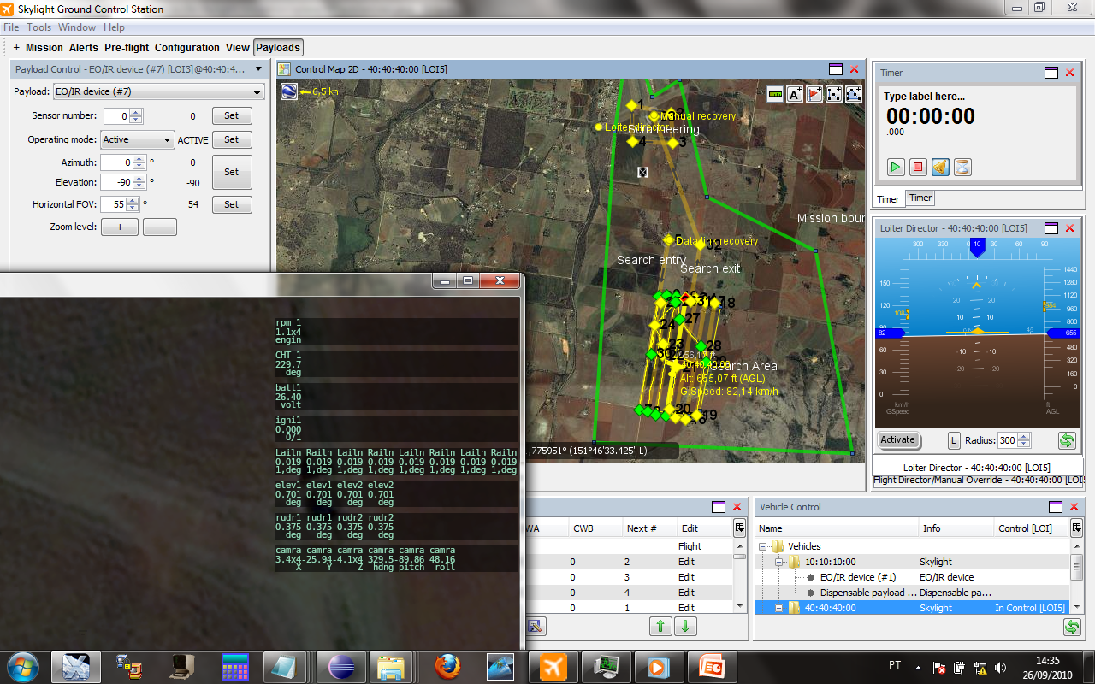
Our ground station

Slide 18
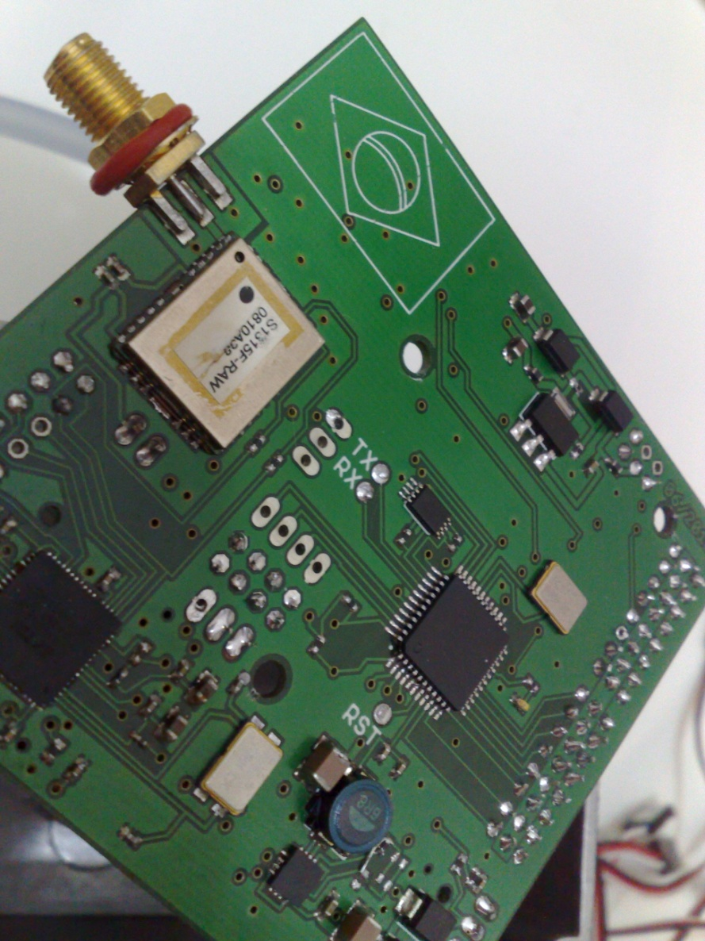
Our autopilot

Slide 19
Questions?

